Slide 1
MCDA 5520 Statistics & Business Analytics
Class 2 – Review of Probability Distribution
Michael Zhang

Slide 2

Risk
Possibility of loss or injury, peril, a dangerous of factor
Exposure to possible economic loss or gain arising from involvement in construction process
A variable in the process of constructing a project whose results in uncertainty in the final cost to the owner
Put simply, risk is a state of uncertainty where some of the possibilities involve a loss, catastrophe, or other undesirable outcome

Slide 3

Risk
Risk is considered in terms of its parent – uncertainty
Uncertainty is the set of all potential outcomes, both favorable and unfavorable
Unfavorable outcomes represent risk
Favorable outcomes represent opportunity

Slide 4

Strategies for Handling Risk
Mitigate: Reduce the probability or impact
Avoid: Eliminate unacceptable risks
Transfer: Move the responsibility, as in insurance
Accept: Prepare for the worst and be ready to act

Slide 5
Probability Distribution
A probability distribution is a table, formula, or graph that describes the values of a random variable and the probability associated with these values
Probability Notation: the probability that the random variable X will equal x is: P(X = x)
Example 1: In a binominal experiment, the probability of exactly x successes in n trials is

Slide 6
Probability Distribution
Example 2
Experiment – tossing a coin twice
Random variable X – number of heads observed
Calculate the probability associated with each value of X and construct the probability distribution
X can assume values of 0, 1 and 2
Probability Distribution for Coin-Toss Experiment
X | P(X)
0 | ¼
1 | ½
2 | ¼

Slide 7
Probability Distribution
Example 3
Experiment – tossing a coin three times
Random variable X – number of heads observed
Calculate the probability associated with each value of X and construct the probability distribution
X can assume values of 0, 1, 2 and 3
Property of Probability Distribution
1. 0 ≤ P (X) ≤ 1 for all X
2. ∑ P (X) = 1
all x

Slide 8
Expected Value
Expected value, mean value, or average value, of a random variable X is denoted E(X). (Expectation of X).
E(X) = the weighted average of its possible outcomes, with the probabilities as weights.
For a random variable X with outcomes x₁, x₂, …, x_{n} with probabilities P₁, P₂, …, P_{n}
E(X) = x₁P₁ + x₂P₂ + x₃P₃ +…+ x_{n}P_{n}
Example: Toss a coin three times, find the the expected value of heads that will occur.
Notes:
We will learn LATER about the relationship with the MEAN.
Some more examples (more useful than the die example):
When winning a lottery, the chance of a first price (valued at 100.000) is
1% , an second price (valued at 10.000) is 9% and a third price
(valued at (1.000) is 90%. What is the expected value of the winning
ticket?
100.000*0.01 + 10.000*0.09 + 1.000*0.9 = 2800

Slide 9
Probability Distributions
Random
Variables
Discrete
Random Variable
Continuous
Random Variable
Binomial
Normal
Poisson
Uniform
Hypergeometric
Exponential

Slide 10
Continuous Probability Distributions
A continuous random variable can assume any value in an interval on the real line or in a collection of intervals.
It is not possible to talk about the probability of the random variable assuming a particular value.
Instead, we talk about the probability of the random variable assuming a value within a given interval.

Slide 11
Continuous Probability Distributions
Uniform Probability Distribution
Normal Probability Distribution
Exponential Probability Distribution
f (x)
Exponential
Uniform
f (x)
Normal
f (x)
x
x
x

Slide 12
Continuous Probability Distributions
Uniform Probability Distribution
Normal Probability Distribution
Exponential Probability Distribution
f (x)
Exponential
Uniform
f (x)
Normal
f (x)
x
x
x

Slide 13
Properties of Probability Density Functions (PDF)
f(x) ≥ 0 for all x
Total area under f(x) = 1
There are always infinitely many values for X
P(X = x) = 0
We can only define probabilities over intervals: e.g.,
P( c < X < d), P(X < c), or P(X > d)

Slide 14
Cumulative Distribution Function (CDF)
F(x) specifies the probability that the random variable X will be less than or equal to x; that is, P(X ≤ x).
F(x) is equal to the area under f(x) to the left of x
The probability that X is between a and b is the area under f(x) from a to b = F(b) – F(a)
or: P(a≤ X ≤b)= F(b) – F(a)

Slide 15
Discrete Random Variable Summary Measures
Standard Deviation of a discrete distribution
where:
x = Values of the random variable
E(x) = Expected value of the random variable
P(x) = Probability of the random variable having the value of x

Slide 16
Discrete Random Variable Summary Measures
Example: Toss 2 coins, x = # heads; Compute standard deviation (recall E(x) = 1)
Possible number of heads = 0, 1, or 2

Slide 17
Binomial Distribution Characteristics
Mean
P(X)
n = 5 p = 0.1
.6
.4
.2
0
X
0
1
2
3
4
5
P(X)
n = 5 p = 0.5
.6
.4
.2
0
X
0
1
2
3
4
5

Slide 18
Examples – Using Binomial Tables
n = 10
x | p=.15 | p=.20 | p=.25 | p=.30 | p=.35 | p=.40 | p=.45 | p=.50
0 1 2 3 4 5 6 7 8 9 10 | 0.1969 0.3474 0.2759 0.1298 0.0401 0.0085 0.0012 0.0001 0.0000 0.0000 0.0000 | 0.1074 0.2684 0.3020 0.2013 0.0881 0.0264 0.0055 0.0008 0.0001 0.0000 0.0000 | 0.0563 0.1877 0.2816 0.2503 0.1460 0.0584 0.0162 0.0031 0.0004 0.0000 0.0000 | 0.0282 0.1211 0.2335 0.2668 0.2001 0.1029 0.0368 0.0090 0.0014 0.0001 0.0000 | 0.0135 0.0725 0.1757 0.2522 0.2377 0.1536 0.0689 0.0212 0.0043 0.0005 0.0000 | 0.0060 0.0403 0.1209 0.2150 0.2508 0.2007 0.1115 0.0425 0.0106 0.0016 0.0001 | 0.0025 0.0207 0.0763 0.1665 0.2384 0.2340 0.1596 0.0746 0.0229 0.0042 0.0003 | 0.0010 0.0098 0.0439 0.1172 0.2051 0.2461 0.2051 0.1172 0.0439 0.0098 0.0010 | 10 9 8 7 6 5 4 3 2 1 0
 | p=.85 | p=.80 | p=.75 | p=.70 | p=.65 | p=.60 | p=.55 | p=.50 | x
Examples:
n = 10, p = .35, x = 3: P(x = 3|n =10, p = .35) = ?
n = 10, p = .75, x = 2: P(x = 2|n =10, p = .75) = ?

Slide 19
Using Binomial Tables
n = 10
x | p=.15 | p=.20 | p=.25 | p=.30 | p=.35 | p=.40 | p=.45 | p=.50
0 1 2 3 4 5 6 7 8 9 10 | 0.1969 0.3474 0.2759 0.1298 0.0401 0.0085 0.0012 0.0001 0.0000 0.0000 0.0000 | 0.1074 0.2684 0.3020 0.2013 0.0881 0.0264 0.0055 0.0008 0.0001 0.0000 0.0000 | 0.0563 0.1877 0.2816 0.2503 0.1460 0.0584 0.0162 0.0031 0.0004 0.0000 0.0000 | 0.0282 0.1211 0.2335 0.2668 0.2001 0.1029 0.0368 0.0090 0.0014 0.0001 0.0000 | 0.0135 0.0725 0.1757 0.2522 0.2377 0.1536 0.0689 0.0212 0.0043 0.0005 0.0000 | 0.0060 0.0403 0.1209 0.2150 0.2508 0.2007 0.1115 0.0425 0.0106 0.0016 0.0001 | 0.0025 0.0207 0.0763 0.1665 0.2384 0.2340 0.1596 0.0746 0.0229 0.0042 0.0003 | 0.0010 0.0098 0.0439 0.1172 0.2051 0.2461 0.2051 0.1172 0.0439 0.0098 0.0010 | 10 9 8 7 6 5 4 3 2 1 0
 | p=.85 | p=.80 | p=.75 | p=.70 | p=.65 | p=.60 | p=.55 | p=.50 | x
Examples:
n = 10, p = .35, x = 3: P(x = 3|n =10, p = .35) = ?
n = 10, p = .75, x = 2: P(x = 2|n =10, p = .75) = ?

Slide 20
Normal Probability Distribution
The normal probability distribution is the most important distribution for describing a continuous random variable.
It is widely used in statistical inference.
People’ s height, weight
Scientific measurement
Test scores
Amount of rainfall

Slide 21
Normal Distribution
Familiar bell-shaped curve.
Symmetric, median = mean = mode; half the area is on either side of the mean
Range is unbounded: the curve never touches the x-axis Parameters
Mean, m (location)
Variance s² > 0 (scale)
Density function (PDF):

Slide 22
Characteristics
99.72%
95.44%
68.26%
x
μ
μ – 3σ
μ – 1σ
μ + 1σ
μ + 3σ
μ – 2σ
μ + 2σ

Slide 23
Evaluating Normality
Not all continuous random variables are normally distributed
It is important to evaluate how well the data set is approximated by a normal distribution
Construct charts or graphs
For small- or moderate-sized data sets, do stem-and-leaf display and box-and-whisker plot look symmetric?
For large data sets, does the histogram or polygon appear bell-shaped?
Compute descriptive summary measures
Do the mean, median and mode have similar values?
Is the interquartile range approximately 1.33 σ?
Is the range approximately 6 σ?

Slide 24
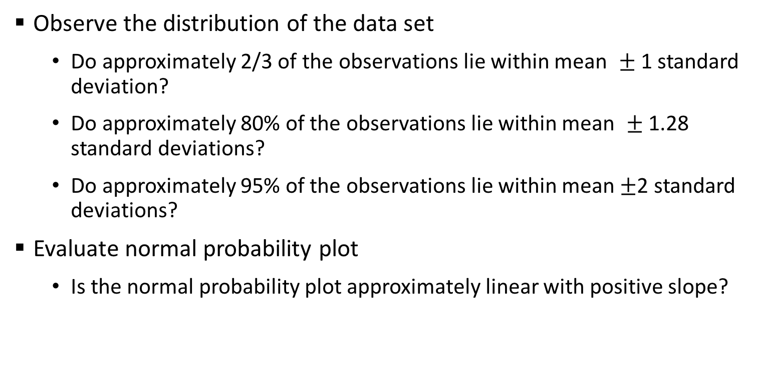
Assessing Normality
Observe the distribution of the data set
Do approximately 2/3 of the observations lie within mean $±$1 standard deviation?
Do approximately 80% of the observations lie within mean $±$ 1.28 standard deviations?
Do approximately 95% of the observations lie within mean $±$2 standard deviations?
Evaluate normal probability plot
Is the normal probability plot approximately linear with positive slope?

Slide 25
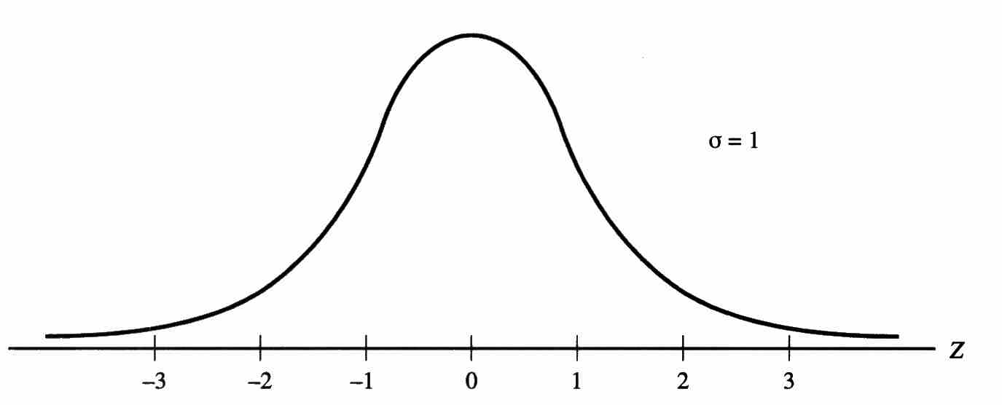
Standard Normal Distribution
Standard normal: mean = 0, variance = 1, denoted as N(0,1)
Transformation from N(m,s) to N(0,1):
z

Slide 26
Z Table Example
Suppose x is normal with mean 8.0 and standard deviation 5.0. Find P(8 < x < 8.6)

Slide 27
Solution: Finding P(0 < z < 0.12)
Standard Normal Probability
Table (Portion)
P(8 < x < 8.6)
= P(0 < z < 0.12)
z
.00
.01
.02
.0478
0.0
.0000
.0040
.0080
0.1
.0398
.0438
.0478
0.2
.0793
.0832
.0871
Z
0.3
.1179
.1217
.1255
0.00
0.12

Slide 28
General Procedure for Finding Probabilities
To find P(a < x < b) when x is distributed normally:
Step 1: Draw the normal curve for the problem in terms of x
Step 2: Translate x-values to z-values
Step 3: Use the Standard Normal Table

Slide 29
Normal Probability Example
Customer demand averages 750 units/month with a standard deviation of 100 units/month.
Find P(X>900), P(X> 700), and the level of demand that will be exceeded only 10% of the time.

